Slide 1
Empower your AI transformation with full potential of NVMe SSD
PRESENTED BY:
Leander Yu
GRAIDTECH.COM

Slide 2
Agenda
Introducing Graid Technology Inc.
Global Partnerships & Recognition
Giga-computing with SupremeRAID™ solution
The ultimate storage solution for BeeGFS, unleashing the power of 400G NIC
Infinitisoft AI cloud services with SupremeRAID™ solution

Slide 3




Graid Technology Inc.
  HQ in Silicon Valley
  R&D center in Taipei, Taiwan
  Global Partners & Resellers
The New Standard in Enterprise Data Protection
& Performance
  We’ve developed the world's first NVMe and NVMeoF RAID card to unlock the full potential of your SSD performance.
  Our extraordinary software plus hardware solution is the most powerful and flexible NVMe SSD RAID in the world.

Slide 4
SupremeRAID™
Global Partnerships & Recognition

Slide 5























Global Partners

Slide 6


































Global Partners, Distributors & Resellers

Slide 7

Giga-computing with SupremeRAID™ solution
x

Slide 8

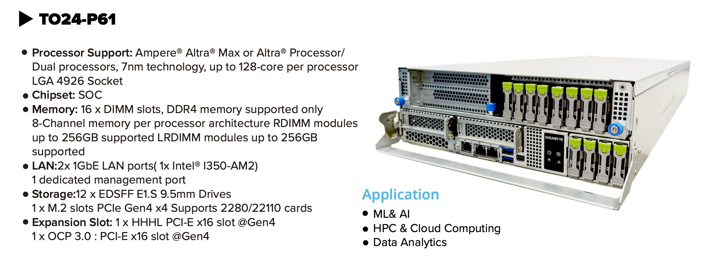
Scalable and Efficient Solution with OCP

Slide 9
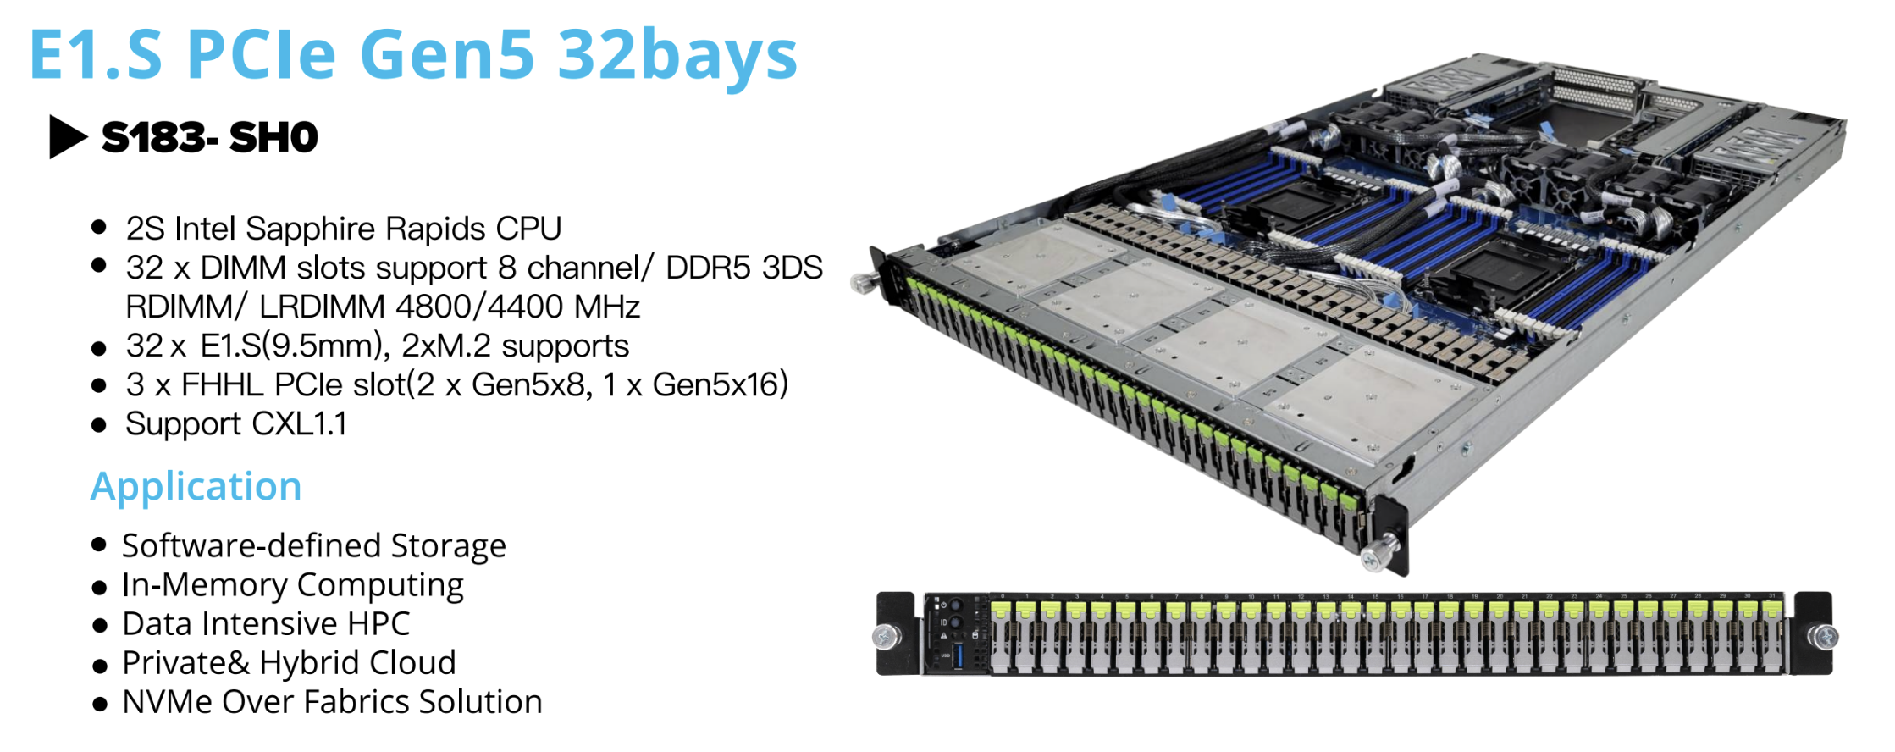
Future of Computing
Step into the computing of tomorrow today

Slide 10

Top-tier Performance on RAID5/6 Write
  SupremeRAID™ delivers over 220GB/s of read throughput and 90GB/s of write throughput on RAID5/6 in the GigaComputing S183-SH0 1U Rack server
220GB/s
Sequential Read
90GB/s
Sequential Write

Slide 11
SupremeRAID™
The Ultimate Storage Solution for BeeGFS, Unleashing the Power of 400G NIC

Slide 12



The Ultimate Fusion: SupremeRAID™ + BeeGFS
Data Well Protected
Superior Performance
130GB/s read and 77GB/s write throughputs from local RAID5 volume in 2U rack
40GB/s read/write from clients, fully saturated 4 x 100G ports
Industry-standard RAID5 protection
2 RAID5 groups, allows 1 SSD failure in each group at the same time
The GPU takes over all rebuild tasks, ensuring user workloads are not affected and network bandwidth is not consumed
Incredible Dense
153.2TB usable capacity per 1U
Up to 398.32TB per 1U with 32 bays fully populated

Slide 13

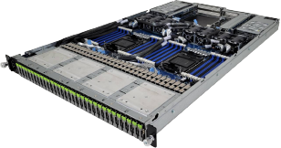
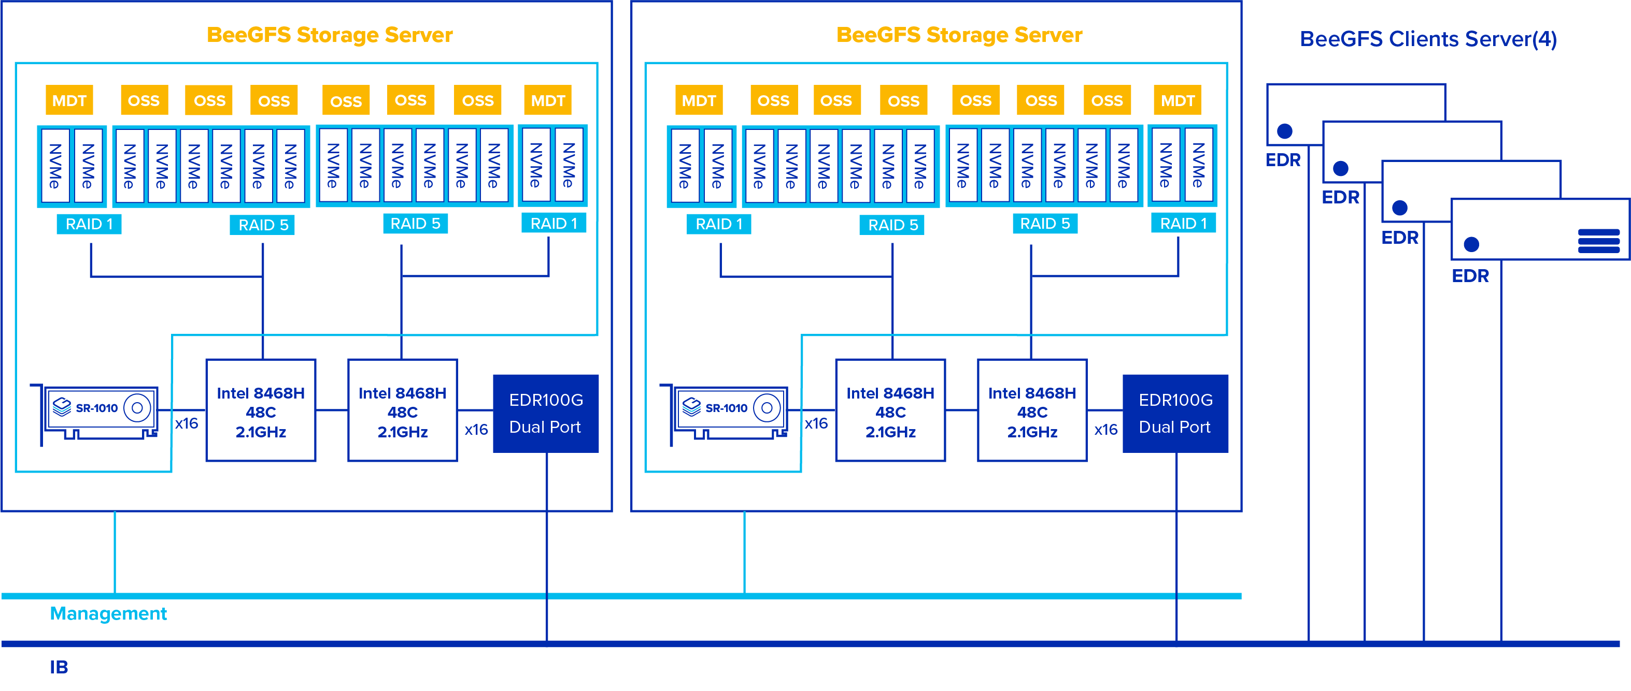
BeeGFS Infrastracture
S183-SH0
S183-SH0

Slide 14
BeeGFS server detailed configuration
Item | Storage server Specification |  |  | Client server Specification
Server | GigaComputing S183-SH0-AAV1 | 2 |  | GigaComputing H242-Z10 (2U4N) | 1
CPU | Intel(R) Xeon(R) Platinum 8468H 48C 2.1GHz | 2 |  | AMD EPYC 7663 56C | 1
Memory | Micron MTC20F2085S1RC48BA1 DDR5 32GB 4800MHz | 16 |  | Micron HMA82GR7CJR8N-XN DDR4 16GB 3200MHz | 8
SSD | SAMSUNG MZTL23T8HCLS-00A07 3.84TB | 16 |  | N/A | -
RAID Card | SR-1010 | 1 |  | N/A | -
Network | ConnectX-5 Ex MCX556A-EDAT EDR | 1 |  | ConnectX-5 MCX556A-ECAT EDR | 1
OFED version | 5.8-2.0.3.0 |  |  | 5.8-2.0.3.0
Operating System | RHEL 8.8 4.18.0-477.13.1.el8_8.x86_64 |  |  | RHEL 8.8 4.18.0-477.13.1.el8_8.x86_64
BeeGFS version | 7.3.3 |  |  | 7.3.3

Slide 15
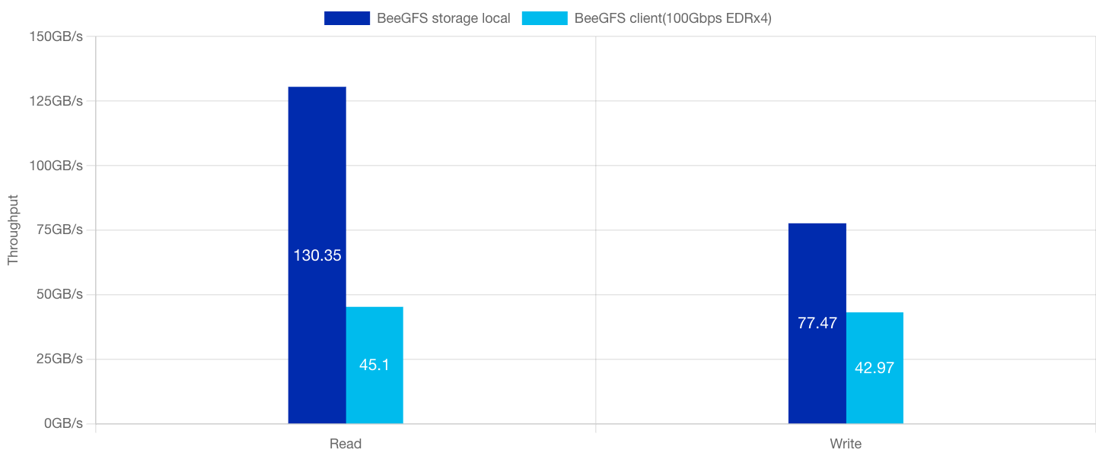
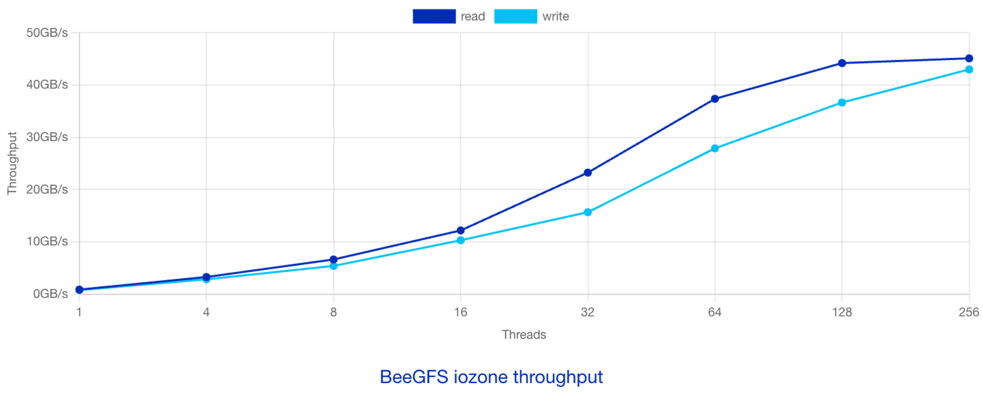
BeeGFS Iozone Performance Result
400Gbps
(50GB/s)
Testing parameter:
Local(storagebench):
$ beegfs-ctl --storagebench --alltargets --write --blocksize=1m --size=16G --threads=256 –odirect
BeeGFS client:
$ /opt/iozone/bin/iozone -i "$type" -MCcew -r 1m –I -s 16g -t 256 -+n -+m hostfile.conf
type=(0,1) [write/read]
Testing parameter:
$ /opt/iozone/bin/iozone -i "$type" -MCcew -r 1m –I -s 16g -t "$thread_count" -+n -+m hostfile.conf
type=(0,1) [write/read]
thread_count=(1,4,8,16,32,64,128,256)

Slide 16

AI-Stack
x
The next leading platform for all AI development and operations.

Slide 17
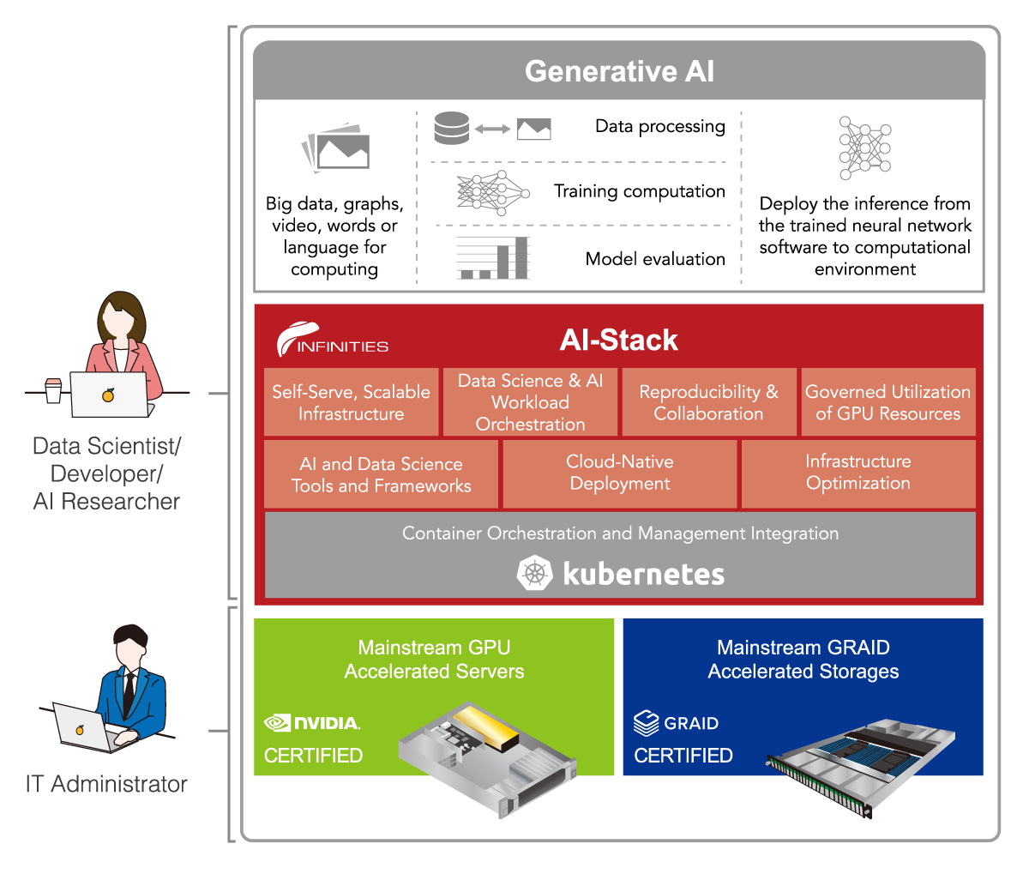
The best AI-Ready Enterprise Platform
AI-Stack pairs NVIDIA GPU and the Enterprise MLOps benefits of workload orchestration, self-serve infrastructure, GPU optimization, and collaboration with the cost-effective scale from containerization on mainstream accelerated servers and storages.
For Data Scientists & AI Researchers
Focus on research instead of dev ops.
Launch AI-Stack on-demand, with NVAIE docker images configured with the latest data science tools, frameworks, and NVIDIA GPUs.
For IT
Get the confidence of enterprise-grade security, manageability, and support.
AI-Stack is validated to run on Kubernetes – all deployed on industry-leading, NVIDIA-Certified systems.
Confidential and Proprietary. Copyright © by InfinitiesSoft Solutions Inc. All Rights Reserved.

Slide 18
Questions?
Thank You
PRESENTED BY:
CEO/ Leander Yu
GRAIDTECH.COM
Copyright © 2021–2022 Graid Technology Inc. All Rights Reserved. SupremeRAID™ is trademarked by Graid Technology Inc. and/or its affiliates in the United States, certain other countries, and/or the EU. The term Graid refers to Graid Technology Inc. and/or its subsidiaries. For more information, please visit www.graidtech.com. Graid Technology Inc. reserves the right to make changes without further notice to any products or data described herein. Information provided by Graid Technology Inc. is believed to be accurate. However, Graid Technology Inc. does not assume any liability arising from the use of any application or product described herein, neither does it convey any license under its patent rights nor the rights of others.

Slide 19
Appendix

Slide 20
BeeGFS config tunning
beegfs-storage.conf | beegfs-meta.conf | beegfs-client.conf
tuneFileReadSize = 1024k | tuneBindToNumaZone | connMaxInternodeNum = 64
tuneFileWriteSize = 1024k |  | connRDMABufNum = 22
tuneNumStreamListeners = 8 |  | connRDMABufSize = 65536
tuneNumWorkers = 64
tuneWorkerBufSize = 4m
connMaxInternodeNum = 128
tuneBindToNumaZone = 0
tuneUseAggressiveStreamPoll = true
tuneUsePerUserMsgQueues = true
connRDMABufNum = 22
connRDMABufSize = 65536

